Slide 1





JavaScript Tools
Tools for Writing / Editing / Debugging JavaScript Code
Svetlin Nakov
Technical Trainer
www.nakov.com
Software University
http://softuni.bg

Slide 2

Table of Contents
JavaScript Development Tools
Visual Studio 2013
Sublime Text with Plugins
WebStorm
Debugging tools
Google Chrome / Opera Developer Tools
Firefox Firebug
Internet Explorer F12
Utilities

Slide 3

JavaScript Tools
Know Your Tools!

Slide 4
JavaScript Tools
JavaScript is an interpreted language
Usually run by the browser
May be run on the server-side
Coding in JavaScript needs just a text editor
Yet, there are many tools that simplify JavaScript coding
Editors, debuggers, code analyzers, etc…
Good JS IDEs support features like:
Integrated debugging, autocomplete, syntax checking

Slide 5


JavaScript Development Tools
Coding JavaScript Made Easy!

Slide 6
JavaScript Development Tools
All a developer needs for coding JavaScript is a text editor
Notepad/Notepad++ will do the trick
Yet, JavaScript is one of the popular guys now
Many, many tools for coding JavaScript
Sublime Text + Plugins
Visual Studio + Node.js Tools
Adobe Brackets, Cloud9, WebStorm, Vim
JavaScript Development Tools for Eclipse

Slide 7

Visual Studio + Node.js Tools

Slide 8
Visual Studio
Visual Studio is the main dev tool for creating .NET apps
ASP.NET, WPF, Silverlight, SharePoint, Windows 8, etc…
VS 2012/2013 are ready-to-use for JavaScript coding
They have pretty good intelli-sense, code highlighting, etc…
There are paid and free versions
Visual Studio Web Developer / Express / Premium / Ultimate
Use Node.js Tools for VS
To enable server-side execution and debugging

Slide 9

Node.js Tools for Visual Studio
Visual Studio has Node.js Tools Plugin
http://nodejstools.codeplex.com
Runs Node.js into Visual Studio
Powerful, well integrated debugger
Has no DOM, runs out of the browser

Slide 10
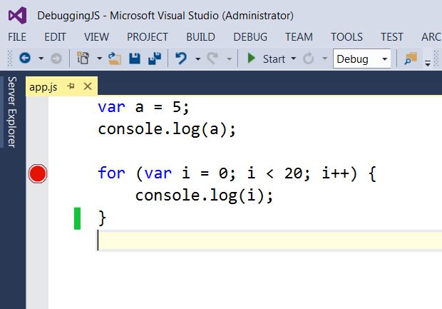
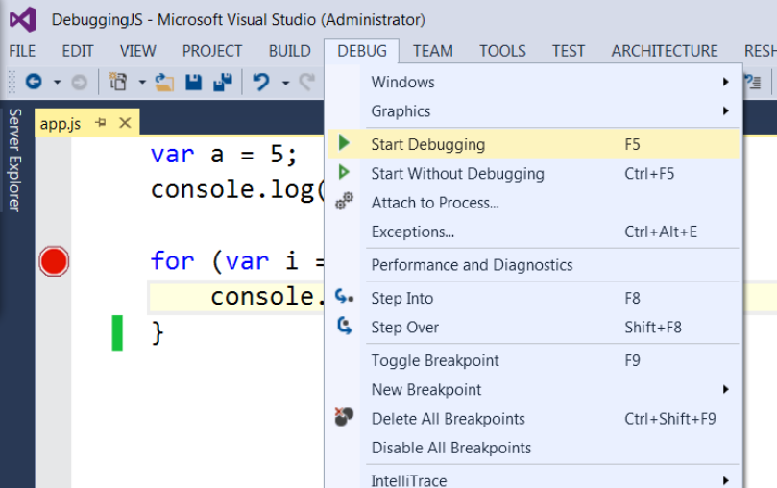
Debugging Node.js in Visual Studio
Just like C# debugger
Add breakpoint and start debugging with [F5]

Slide 11
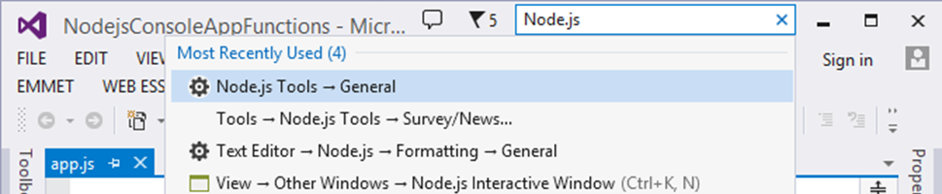
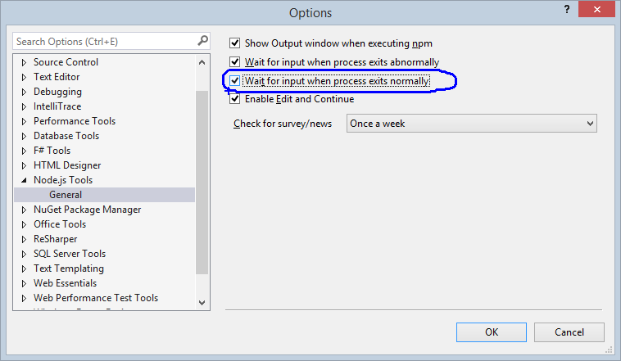
VS + Node.js Tools: Lost Console Output
Problem: the console is lost just after my JS program finishes
I can't see the program output
How to keep it?

Slide 12
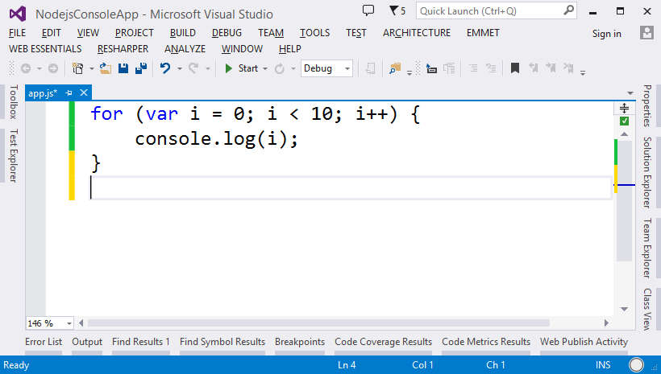
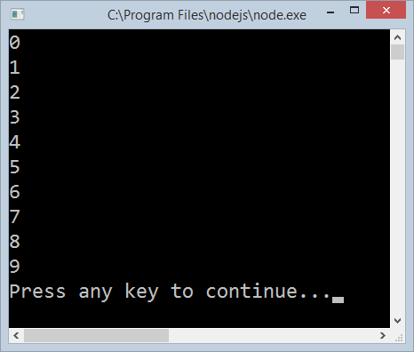
Visual Studio + Node.js Tools
Live Demo

Slide 13
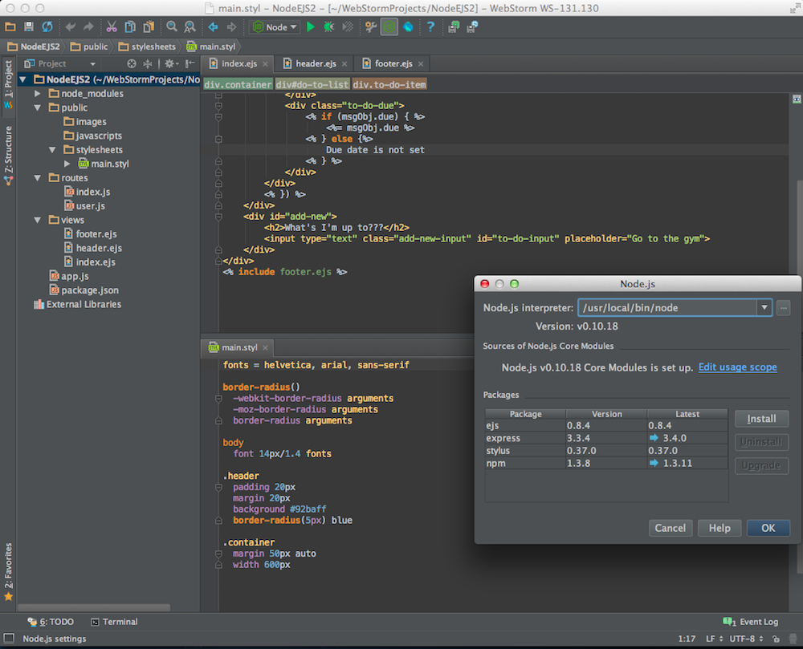
WebStorm
A Very Smart JavaScript IDE

Slide 14
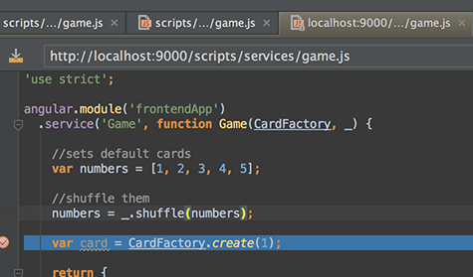
WebStorm
JavaScript IDE suitable for both client-side JS and server-side (Node.js) development
Build JavaScript code
Debug JavaScript code
Code intelli-sense for:
SASS/LESS/Stylus CSS preprocessors
CoffeeScript/TypeScript JavaScript preprocessors
Emmet coding
Paid product (free 1 year license for SoftUni student)

Slide 15
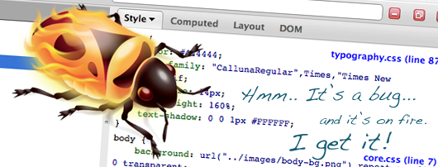
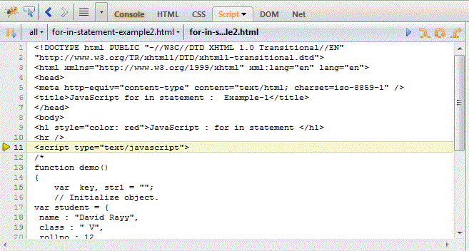
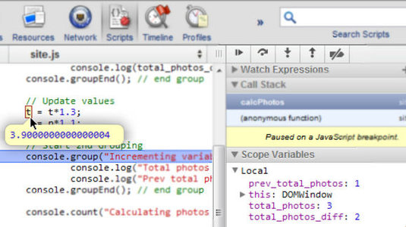
Debugging JavaScript
Using All the Tools

Slide 16
Debugging JavaScript
Sadly, no intelligent way of debugging client-side JavaScript
The only way to debug JavaScript is through the browser
Fortunately all browsers have their own debugging tool / plugin that makes it easier
Firefox has Firebug – http://getfirebug.com
Chrome and Opera have Web Developer Tools
Internet Explorer has [F12]

Slide 17
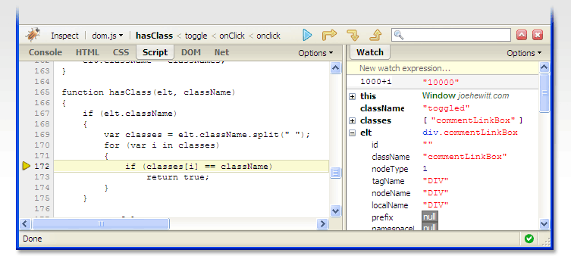
Debugging JavaScript
Live Demo

Slide 18
JavaScript Utilities
Tools for JS Developers

Slide 19
JavaScript Utilities
JavaScript code quality tools
http://www.jshint.com
http://www.jslint.com
HTML, CSS and JavaScript playgrounds
http://jsbin.com
http://liveweave.com
JavaScript performance tester
http://jsperf.com

Slide 20
JavaScript Utilities
Live Demo

Slide 21


Summary
JS Developer Tools
WebStorm
Visual Studio + Node.js Tools
JS Debuggers
The [F12] Tools
JS Utilities
JSHint, JSLint, JSBin, …
JS Basics

Slide 22







JavaScript Tools
https://softuni.bg/courses/javascript-basics

Slide 23
License
This course (slides, examples, demos, videos, homework, etc.) is licensed under the "Creative Commons Attribution-NonCommercial-ShareAlike 4.0 International" license
Attribution: this work may contain portions from
“JavaScript Basics" course by Telerik Academy under CC-BY-NC-SA license

Slide 24





Free Trainings @ Software University
Software University Foundation – softuni.org
Software University – High-Quality Education, Profession and Job for Software Developers
softuni.bg
Software University @ Facebook
facebook.com/SoftwareUniversity
Software University @ YouTube
youtube.com/SoftwareUniversity
Software University Forums – forum.softuni.bg

